Slide 1

Multiparametric and Converse Terapeutic hierarchy in HCC
Prof. Alessandro Vitale
Hepatobiliary surgery and Liver Transplant Unit
Director: Prof. Umberto Cillo
Padua University Hospital
alessandro.vitale@unipd.it

Slide 2

Multiparametric and Converse Therapeutic Hierarchy in HCC
From pre-Ptolemaic to Ptolemaic era
Notes:
The main reason is that the BCLC algorithm for HCC treatment is like the Ptolemaic System, It is fascinating for its simplicity, and because makes HCC managment easy also without a tumor board, but it is conceptually wrong.

Slide 3
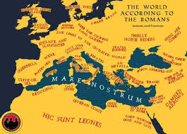
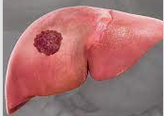
HCC 1998: hic sunt leones!
From pre-Ptolemaic to Ptolemaic era
BCLC 1999
There are four main factors affecting prognosis:
the stage … of the tumor;
the general health of the patient;
the liver function of the patient;
the specific intervention.
In the late 1990s, no evidence existed supporting transarterial or systemic therapies as treatments for patients with HCC, and only three therapeutic options were known to confer survival benefit: liver transplantation, hepatic resection, and percutaneous ethanol injection
Trevisani F, Vitale A … Cillo U. J Hepatol 2024
Notes:
Before 1999 there was a pre-ptolemaic era of great confusion and anarchy in the management of HCC. The arrival of BCLC In 1999, was therefore extremely important, because it put order to this confusion.
In 2000 there was the first consacration of BCLC with this sentence I loved very much: there are four main factors…

Slide 4
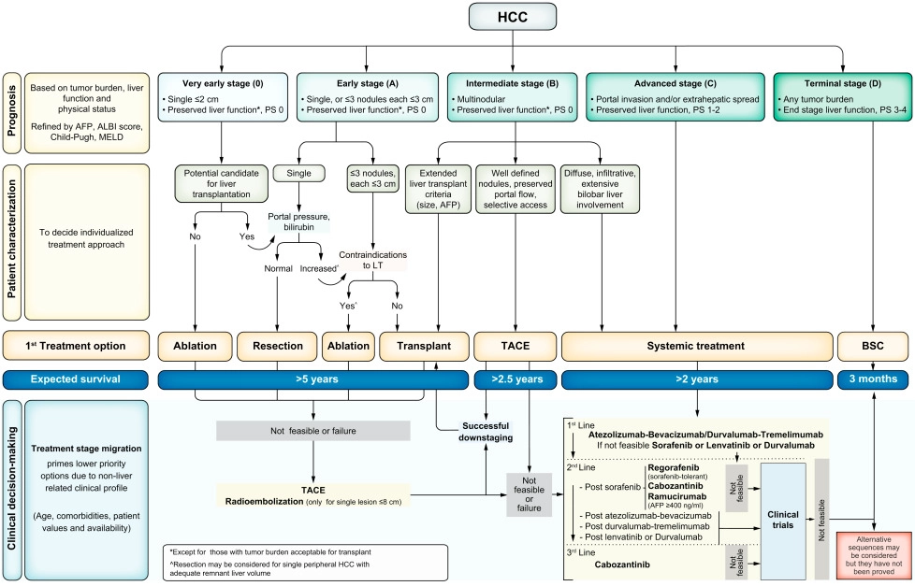
From pre-Ptolemaic to Ptolemaic era
The BCLC staging
^{Reig M, et al. J Hepatol 2022.}
Singal AG, et al. Hepatology 2023.
Evidence-based approach
Comprehensive vision (patient, tumor, liver function)
Prognostic role of Treatment
Prognostic accuracy (stage stratification)
Simplicity (for clinicians and patients)
International consensus (guidelines)
Comparision of results (RCT design)
Merits of the BCLC staging
Trevisani F, Vitale A … Cillo U. J Hepatol 2024
Notes:
In these first years the BCLC had a lot of merits: it introduced an evidence base approach, ….
These merits are mainly related to the BCLC staging. So, the problem was not the staging. The BCLC staging is good. The problem was and is the BCLC algorithm, its rigidity and the way it has been imposed in the last 20 years.

Slide 5
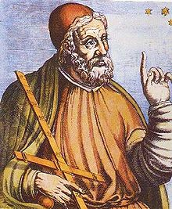
Multiparametric and Converse Therapeutic Hierarchy in HCC
From pre-Ptolemaic to Ptolemaic era
Merits of Stage Hierarchy
The Ptolemaic System
Notes:
The main reason is that the BCLC algorithm for HCC treatment is like the Ptolemaic System, It is fascinating for its simplicity, and because makes HCC managment easy also without a tumor board, but it is conceptually wrong.

Slide 6
The Ptolemaic System (stage hierarchy)
BCLC algorithm boundaries
STAGE HIERARCHY DEFINITION
Treatment is considered
an outcome variable
similar to survival.
STAGE
HIERARCHY
Outcome
Stage
Treatment
Ptolemaic System
M Iavarone slide modified from an idea of Professor E Giannini
Vitale A, Cabibbo G, et al, Lancet Oncol 2023; 24: e312–22
Notes:
Like in the Ptolemaic System, the BCLC mistake is to consider the HCC stage at centre of the Universe of HCC treatment decision. Treatment choice depends only by stage. Each stage or substage has a singole treatment option. In this picture taken from our Lancet Oncology paper, we explain that there is a superimposition of prognostic and trreatment indications, this means that a negative prognostic factor, like portal hypertension or multinodular, becomes absolute contraindications to a specific treatment like a resection.

Slide 7
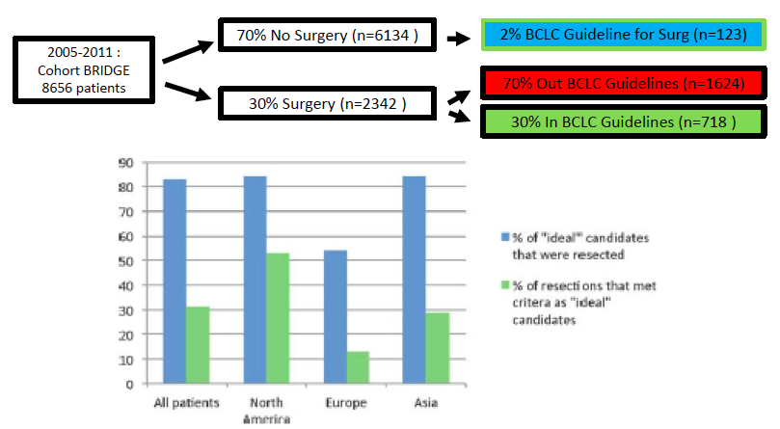
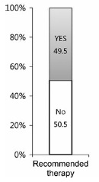
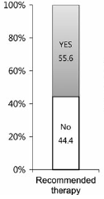
The Ptolemaic System (stage hierarchy)
BCLC algorithm boundaries
BCLC has been accused of “rigidity”, which would limit its utility in real life.
NON ADHERENCE
BCLC
HKLC
Roayaie S, et al. Hepatology 2015; ^{62: 440}
^{Kim KM, et al. Liver Int 2016.}
Notes:
The first consequence of this conceptual mistake is that in clinical practice there is a very poor adherence to the algorithm both in the surgical world, and in the non surgical world, both in early and in intermediate-advanced stages

Slide 8
The Ptolemaic System (stage hierarchy)
BCLC algorithm boundaries
UNDER-TREATMENT
Vitale A, Cabibbo G, et al, Lancet Oncol 2023; 24: e312–22
Notes:
The second and most important consequence is the high risk of undertreatment inherent to the BCLC algorithm. So the high risk that treatment decision beyond BCLC guidelines have a better outcome than therapies within guidelines. There are a lot of studies showing this limits, and in these two tables from the Lancet Oncology study you have only some examples.

Slide 9


Multiparametric and Converse Therapeutic Hierarchy in HCC
From pre-Ptolemaic to Ptolemaic era
Merits of Stage Hierarchy
The Ptolemaic System
Boundaries of Stage Hierarchy
The Copernican and Newton’s evolutions
Notes:
So, which is the solution according to us. The solution is a completely different way of thinking, a drastic paradigm change, like in the Copernican revolution.

Slide 10
The Copernican Evolution
TREATMENT AS INDIPENDENT ORDINAL PROGNOSTIC VARIABLE
STAGE
HIERARCHY
THERAPEUTIC
HIERARCHY
Outcome
Stage
Outcome
Stage
Treatment
Treatment
Ptolemaic System
Copernican Revolution
M Iavarone slide modified from an idea of Professor E Giannini
Vitale A, Cabibbo G, et al, Lancet Oncol 2023; 24: e312–22
Notes:
Like in the Copernican revolution, the stage is never at centre of the universe, but it is the treatment choice at the centre of the Universe influencing HCC outcome. This is the conpet of therapeutic hierarchy where treatment choice is prognostically independent from tumor stage.

Slide 11
The Copernican Evolution
OVER-TREATMENT
ORDINAL THERAPEUTIC HIERARCHY: indipendence of the «ordinal variable» treatment from staging
This concept forces clinicians to adopt Personalized therapy: choice of the BEST THERAPY
Vitale A, et al. Liver Int 2019. doi: 10.1111/liv.14154.
Vitale A et al, Hepatology. 2020 Feb 16.
Notes:
But treatment variable is not only independent from stage, it is also ordered in a hierarchical order in terms of suvival benefits. LT is at the first place, after you have LR, after ablation, after IAT, after systemic therapy. However, also this approach may have some problems, particularly in unexperienced hands, and the risk is that of OVERTREATMENT.

Slide 12
The Newton’s evolution
STAGE
HIERARCHY
MULTIPARAMETRIC THERAPEUTIC
HIERARCHY
THERAPEUTIC
HIERARCHY
Stage
Outcome
Outcome
Stage
Outcome
Stage
Treatment
Treatment
Treatment
Patient
Ptolemaic System
Newton’s evolution
Copernican Revolution
M Iavarone slide modified from an idea of Professor E Giannini
Notes:
For this reason we thought to an improvement in these last two papers, and the improvement is the concept of Multiparametric therapeutic hierarchy, in which is the Patient at the centre of the Universe, and the treatment choice is personalized.

Slide 13
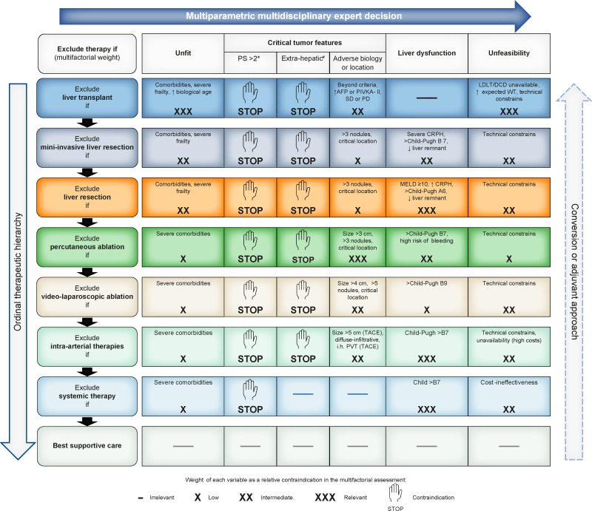
Multiparametric Therapeutic Hierarchy
Trevisani F, Vitale A … J Hepatol 2024
Vitale A, et al. Lancet Oncology 2023

Slide 14
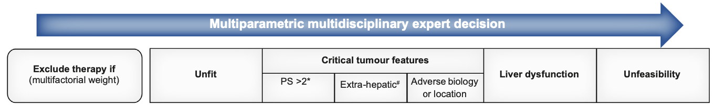
Multiparametric Therapeutic Hierarchy
Ngonadi C, et al. Transplantation 2025. DOI: 10.1097/TP.0000000000005519

Slide 15
Multiparametric Therapeutic Hierarchy
Norman JS, et al. Journal of Hepatol 2023; 79: 1469-1477

Slide 16
Multiparametric Therapeutic Hierarchy
Sha M, et al. Clinical and Molecular Hepatology 2025;31(Suppl):S285-S300
van der Meeren PE, et al. Hepatology. 2025;82:212–231

Slide 17
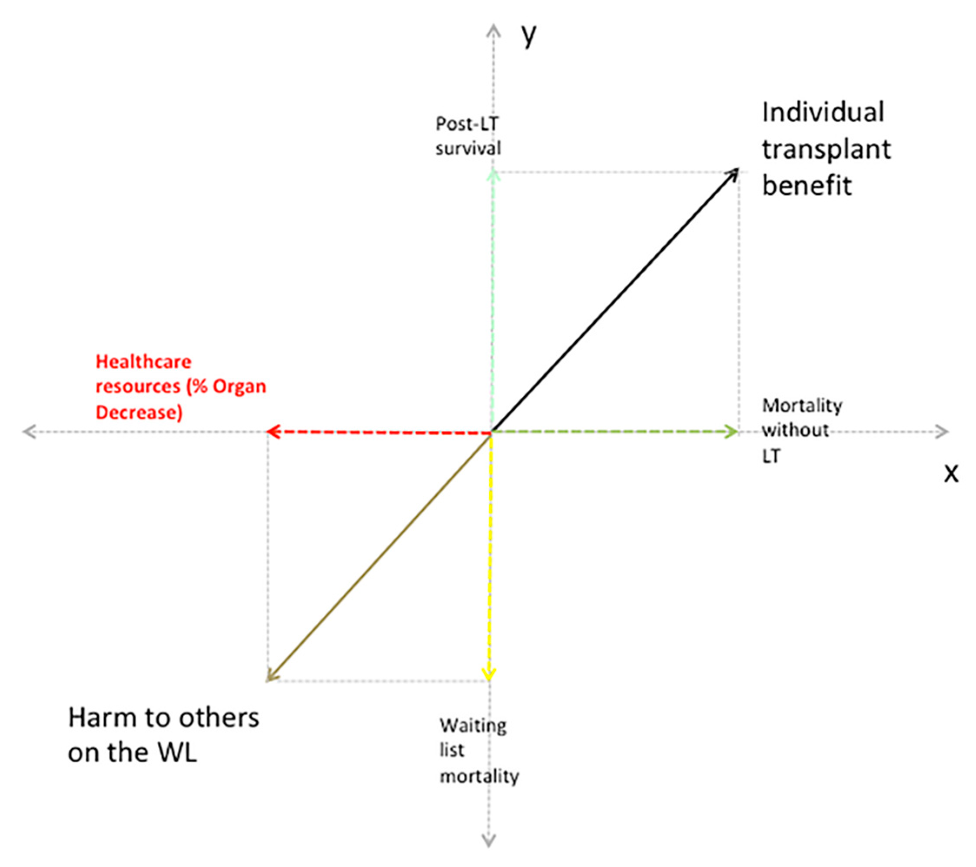
Multiparametric Therapeutic Hierarchy
LT for LOW BENEFIT HCC?
Geographic areas with high resources (Norway)
LIVING DONORS
Non Heart Beating donors
Machine perfusion
AB or B blood groups
Cillo U, et al. Cancers 2021; 13: 1416

Slide 18
Multiparametric Therapeutic Hierarchy
ITALIAN multi-society guidelines 2023
Digestive and Liver Disease 56 (2024) 223–234
Digestive and Liver Disease 56 (2024) 394–405

Slide 19
Multiparametric Therapeutic Hierarchy
ESMO guidelines 2025
Vogel A, et al. Ann Oncol.2025: S0923-7534(25)00073-0.

Slide 20
Multiparametric Therapeutic Hierarchy
A multidisciplinary approach to treatment
Different therapies must be considered based on individual patient scenarios, and therapeutic options frequently overlap. Therefore, optimal management of HCC requires the opinion and expertise of various specialists, making a coordinated multidisciplinary team (MDT) essential.
… Every patient with HCC should be assessed by an expert MDT at the time of initial presentation and whenever a change in treatment objectives is anticipated.
J Hepatol. 2025 Feb;82(2):315-374. doi: 10.1016/j.jhep.2024.08.028.

Slide 21
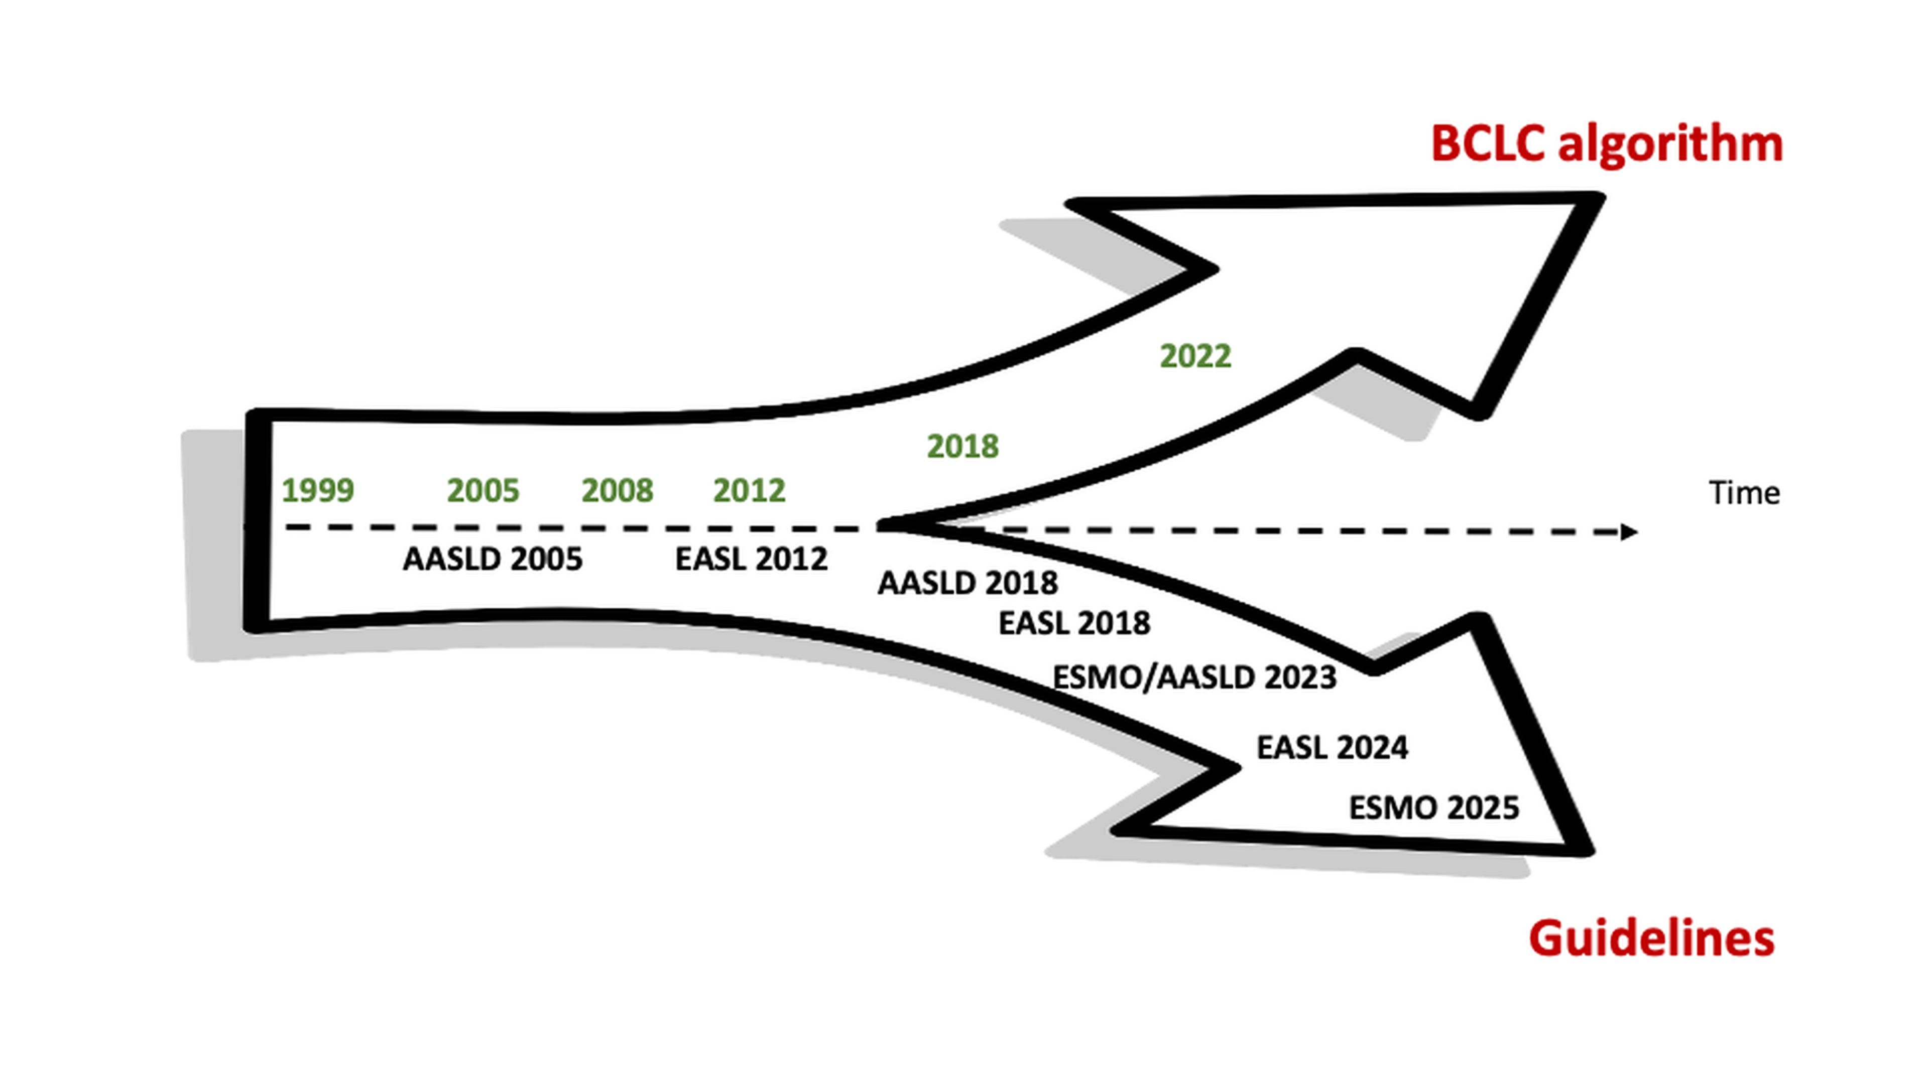
Multiparametric Therapeutic Hierarchy
From stage (mono-parametric) to treatment (multi-parametric) hierarchy

Slide 22
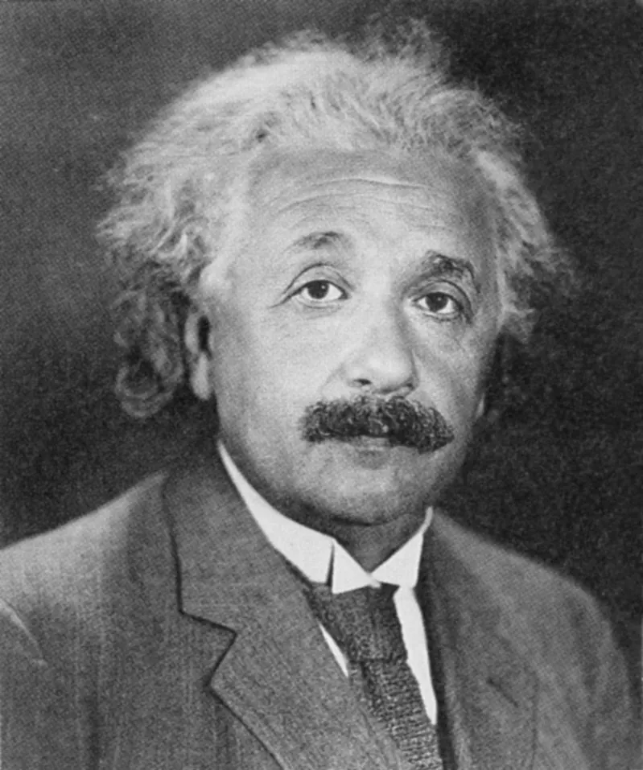
Multiparametric and Converse Therapeutic Hierarchy in HCC
From pre-Ptolemaic to Ptolemaic era
Merits of Stage Hierarchy
The Ptolemaic System
Boundaries of Stage Hierarchy
The Copernican and Newton’s evolutions
Multiparametric Therapeutic Hierarchy and expert MDT
The Einstein’s relativity
Notes:
The last slides I want to show you another conceptual evolution of this scheme.

Slide 23
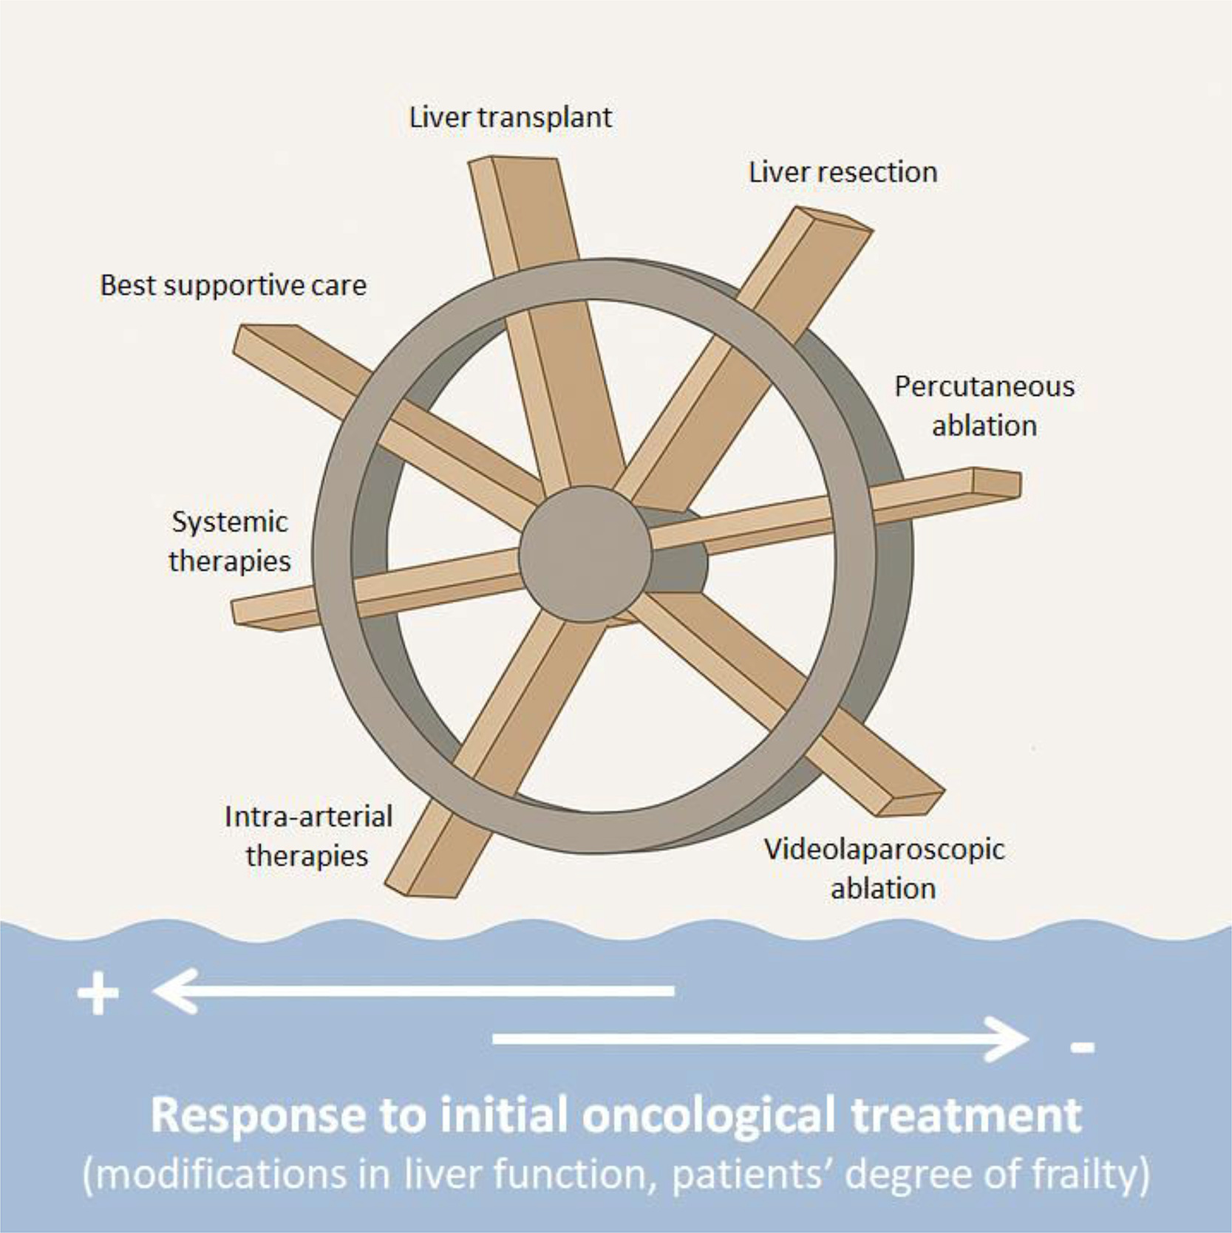
The Einstein’s relativity
CONVERSION INTENT
CURATIVE INTENT
Stage
Outcome
Treatment
Patient
Giannini EG, et al. DLD 2025. In press
Trevisani F, Vitale A … Cillo U. J Hepatol 2024
M Iavarone slide modified from an idea of Professor E Giannini
Vitale A, Cabibbo G … Cillo U. Lancet Oncology 2023
Notes:
Like in the Einstein relativity, this multiparametric scheme can be used in different clinical scenarios, CLINICAL INTENTS. The first INTENT can curative.
Represented from this ARROW FROM TOP TO BOTTOM. It is important to underline that it is probably wrong the old distintiction between curative and palliative therapies. There is a continuum of potenial for radicality that is maximum with LT but it is present also with intra arterial therapies and systemic therapy. So we can obtain a potenial cure also with IAT and systemic therapy, and this should be our aim.

Slide 24
PROBLEM 1
The Einstein’s relativity
🇨🇳 China & 🇯🇵 Japan as the Master of Conversion to Resection in HCC
📌 Origin of the Concept: Since the late 2000s, Chinese clinicians have explored combined conversion approaches (TACE, intra-arterial chemo, ablation)
📌 Concept Formalization: In 2021, the first national Expert Consensus officially defined 'Conversion Therapy'
📌 Official Definition: Therapy aiming to achieve radical surgical resection in patients with CNLC stage IIb, IIIa, or selected PVTT.
📌 Preferred Strategies: TACETKIs / ICI, radiotherapy on PVTT, high-intensity multimodal approaches.
📌 Outcome: Widespread clinical adoption, numerous publications, and a conceptual framework anticipating Western therapeutic hierarchies.
Sun HC et al., HepatoBiliary Surg Nutr 2022;11(2):227-252
Chen QF et al., Journal of Clinical and Translational Hepatology 2024 vol. 12(3) | 298–304
Notes:
Let us begin with China. Since the late 2000s, Chinese clinicians have explored combined conversion strategies—such as TACE, intra-arterial chemotherapy, and ablation—for initially unresectable HCC. In 2021, this experience was formalized into the first national Expert Consensus on Conversion Therapy. According to this definition, conversion aims to achieve radical resection in patients with CNLC stage IIb, stage IIIa, or in selected cases with portal vein tumor thrombosis. Preferred strategies include TACE combined with TKIs or ICIs, radiotherapy for PVTT, and high-intensity multimodal approaches

Slide 25
The Einstein’s relativity
PROBLEM 1
🇪🇺 Europe & 🇺🇸 USA as Masters of Downstaging in HCC LT
📌 While China pioneered the concept of 'Conversion Therapy’ to resection,
📌 Europe and the USA have led the way in 'Downstaging' strategies before liver transplantation for HCC.
📌 Key milestones: Milan, UCSF, Up-to-7, Hangzhou, Toronto, French model, UNOS policy, Metroticket 2.0.
📌 Emphasis on morphology, biological markers, and response to therapy as criteria for transplant eligibility.
📌 Downstaging reflects dynamic assessment: from tumor burden → biological markers → treatment response.
Sha Met al., Clinical and Molecular Hepatology 2025;31(Suppl):S285-S300
Notes:
While China has been the master of conversion, Europe and the USA have been the masters of downstaging before liver transplantation. This history begins with the Milan criteria, then expands with UCSF, the Up-to-7, the Toronto and Hangzhou experiences, the French model, the UNOS policy, and finally Metroticket 2.0. All of these efforts have refined how morphology, biology, and treatment response are used to identify patients who can be successfully downstaged and transplanted

Slide 26
PROBLEM 2
The Einstein’s relativity
Conversion to Resection in HCC
HIGH HETEROGENEITY IN CONVERSION RATES
Bi X et al. Liver Cancer 2025;14:223–238
Notes:
In the same paper, two additional tables show conversion success rates ranging from about 10% to almost 70%. And this wide variability occurs regardless of whether the therapy is systemic alone or combined with loco-regional strategies. This tells us something important: the heterogeneity is not explained only by the treatment used, but rather by the baseline characteristics of the patients and their tumors. This is a potential limitation of the current definition of conversion

Slide 27
PROBLEM 3
The Einstein’s relativity
Conversion/Downstaging & Guidelines
The term CONVERSION is never mentioned!!!
EASL guidelines. J Hepatol. 2025; 82:315-374.

Slide 28
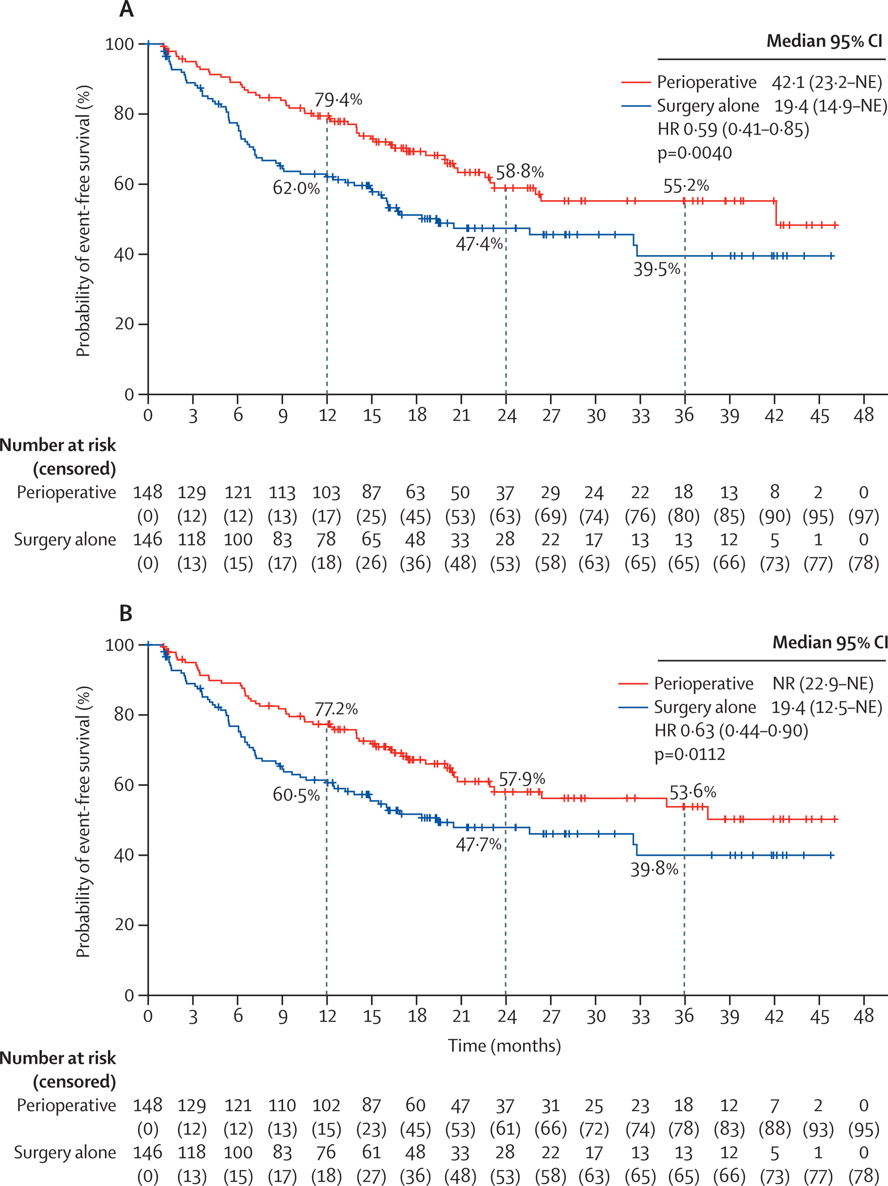
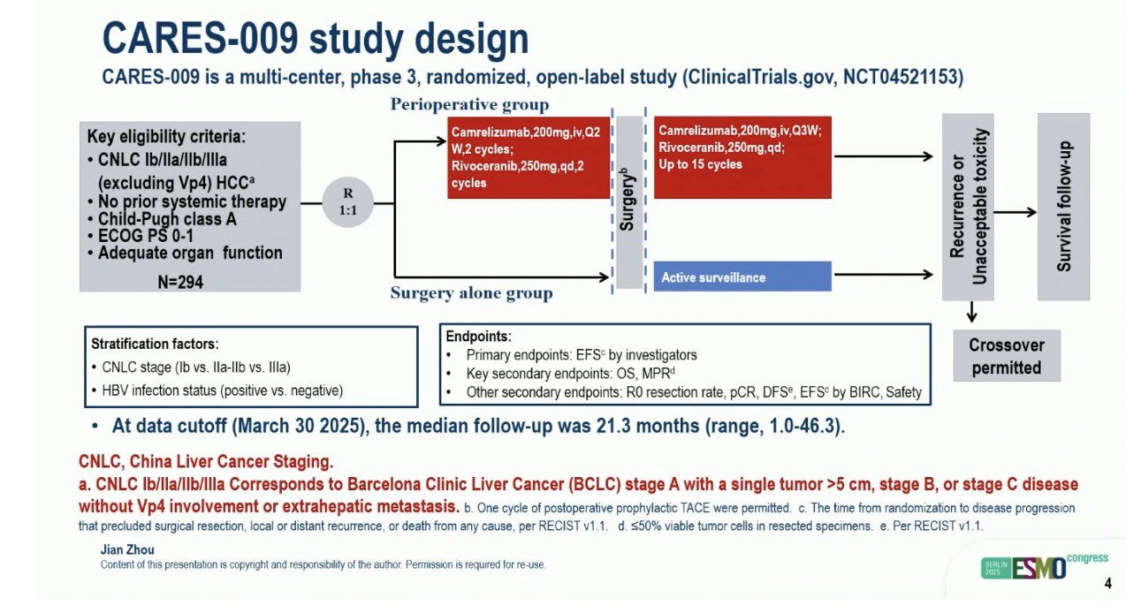
Converse Therapeutic Hierarchy
Neoadjuvant intent therapy
Patient suitable for noncurative intent therapy
(conversion failure after LRT ± systemic therapy/non-oncological procedures)
Bad
(unsuitable)
0%
Patient suitable for conversion intent therapy
(LRT ± systemic therapy/non-oncological procedures)
ONCOLOGICAL CRITERIA
(biological)
1-40%
Patient suitable for downstaging/downsizing
(LRT ± systemic therapy/non-oncological procedures)
Intermediate
(borderline suitable)
40-80%
Patient suitable for neoadjuvant
intent therapy
(LRT ± systemic therapy/
non-oncological procedures)
80-90%
Patient suitable for
upfront curative intent therapy
Good
(suitable)
100%
Easy
(suitable)
Intermediate
(borderline suitable)
Difficult
(unsuitable)
NON-ONCOLOGICAL CRITERIA
(fitness, liver function reserve, technical feasibility)
Vitale A, …. Cillo U. Liver Cancer 2025

Slide 29
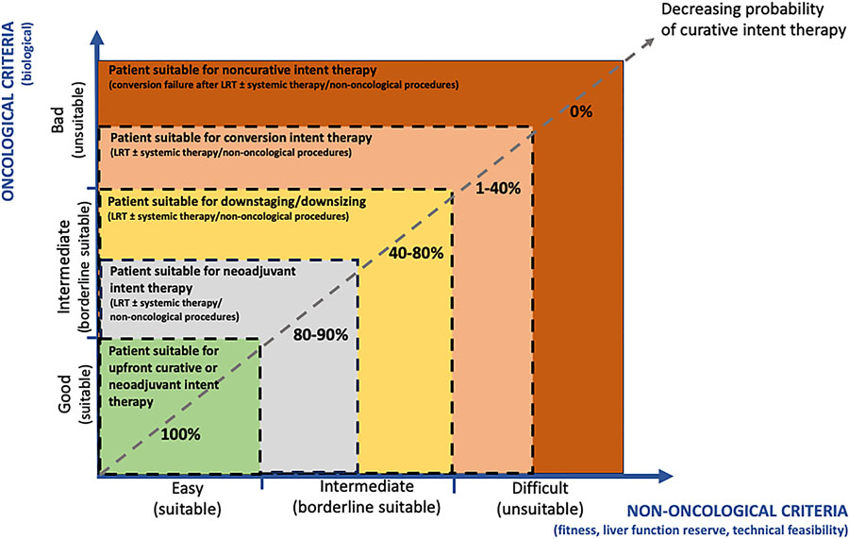
The Einstein’s relativity
Converse therapeutic hierarchy
Vitale A, et al. Liver Cancer 2025. doi:10.1159/000546360
Notes:
Unfortunately, systemic therapy is usually used with a palliative intent represented with this horizontal arrow.

Slide 30
Converse Therapeutic Hierarchy

Slide 31
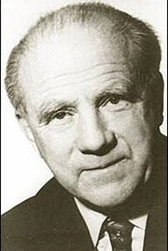
Multiparametric and Converse Therapeutic Hierarchy in HCC
From pre-Ptolemaic to Ptolemaic era
Merits of Stage Hierarchy
The Ptolemaic System
Boundaries of Stage Hierarchy
The Copernican and Newton’s evolutions
Multiparametric Therapeutic Hierarchy and expert MDT
The Einstein’s relativity
Converse Therapeutic Hierarchy
The Heisenberg’s uncertainty
Notes:
The last slides I want to show you another conceptual evolution of this scheme. After embracing the ‘relativity’ of clinical decision-making (Einstein), we realized that HCC also contains a deeper level of complexity: a structural Heisenbergian uncertainty. Just as in Heisenberg’s principle, we cannot perfectly quantify all the dimensions that determine comparative treatment effectiveness — tumour biology, hepatic reserve, frailty, patient values, feasibility. This is precisely why we created MTH-GRADE: to transform inevitable uncertainty into a transparent, systematic and reproducible decision framework, fully aligned with the Core GRADE principles.

Slide 32

The Heisenberg’s uncertainty
Their ’hierarchical approach’1 lacks the same scientific rigor, presenting a contradiction by demanding methodological rigor in prognosis but not in treatment. This inconsistency underlines a flaw in their argument, with most supporting cohorts biased, undermining robust conclusions. Only prospective trials can offer reliable recommendations, underscoring the undervalued potential of systemic therapies in various HCC stages and suggesting a need to revise current treatment approaches
BMJ 2003;327:1459–61

Slide 33
The Heisenberg’s uncertainty
STAGE/EVIDENCE
HIERARCHY
Outcome
Stage/
Evidence
Treatment
Ptolemaic System
ESMO guidelines. Annals of Oncology 2021.

Slide 34
The Heisenberg’s uncertainty
Furthermore, according to GRADE, the strength of a recommendation depends not only on the certainty of evidence but also on the consideration of the balance between treatment benefits and harms, societal values and preferences, resources, feasibility, acceptability, and equity.3 Thus, the absence of prospective trials comparing treatments does not necessarily preclude making evidence-based assumptions, ultimately leading to strong recommendations. From this perspective, the BCLC 2022 lacks a systematic analysis and grading of all available evidence, whereas MTH is much more inclusive.

Slide 35
The Heisenberg’s uncertainty
HIGH CERTAINTY OF EVIDENCE → 1° Treatment Option
UNCERTAINTY OF EVIDENCE → Alternative personalised options
Reig M, et al. J Hepatol. 2025; Oct 27:S0168-8278(25)02571-1. doi: 10.1016/j.jhep.2025.10.020.

Slide 36
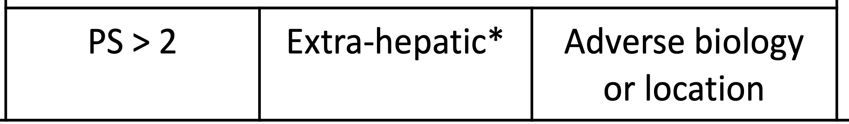
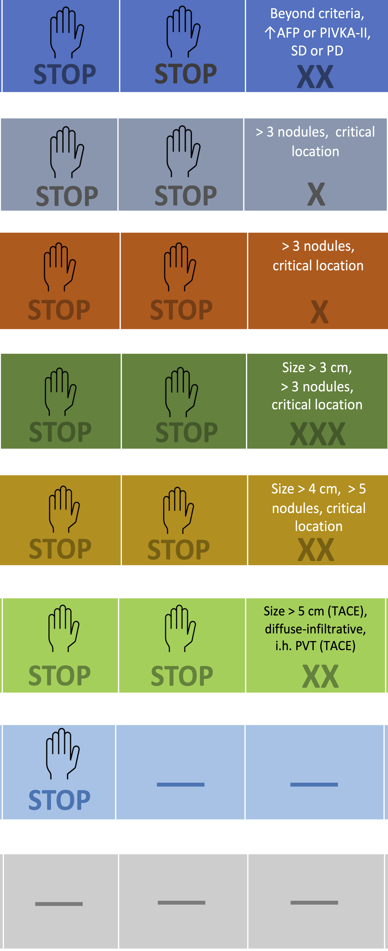
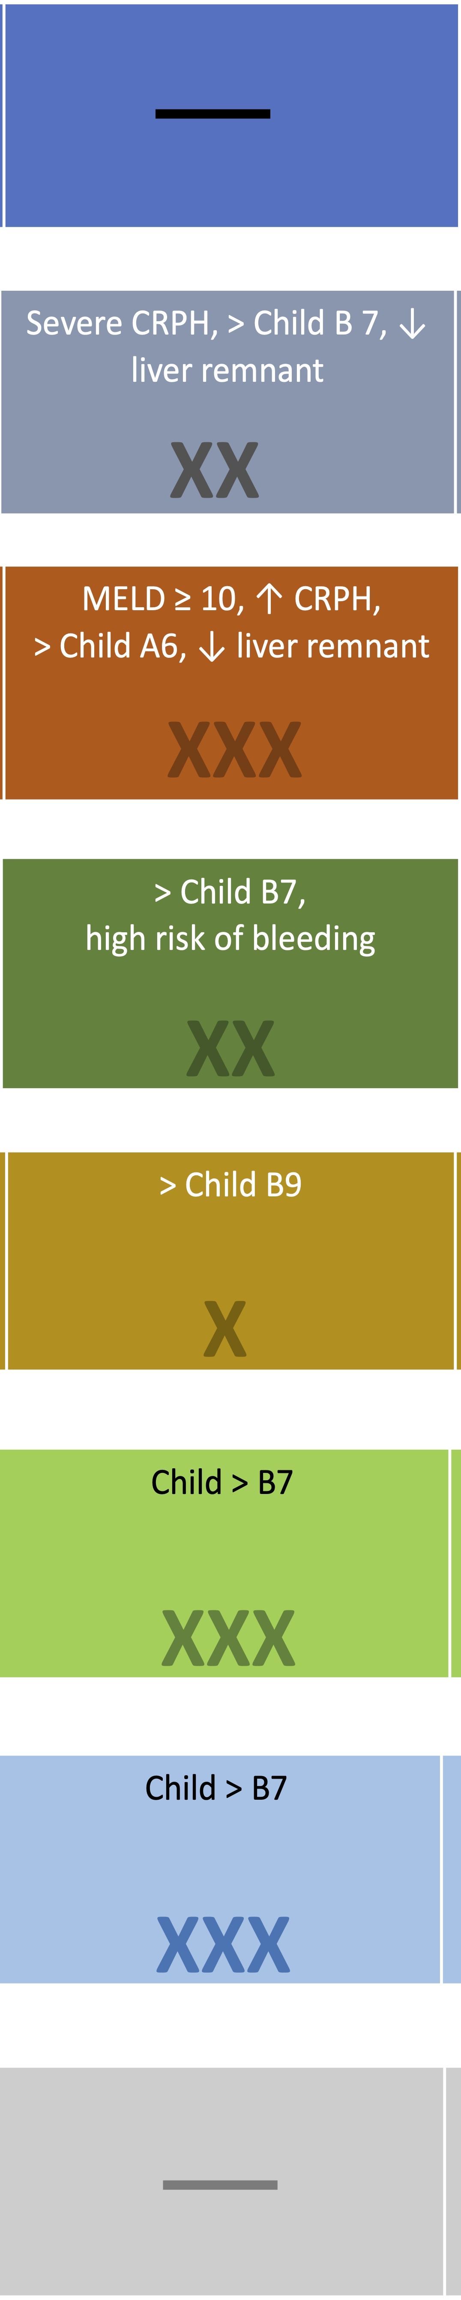
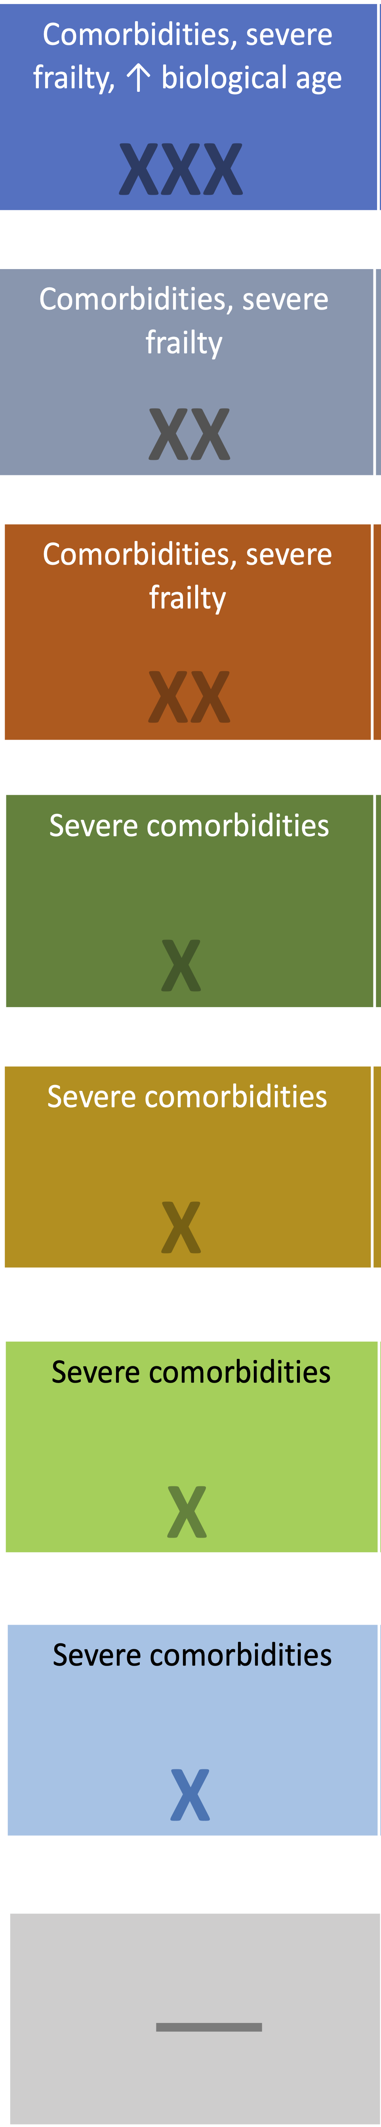
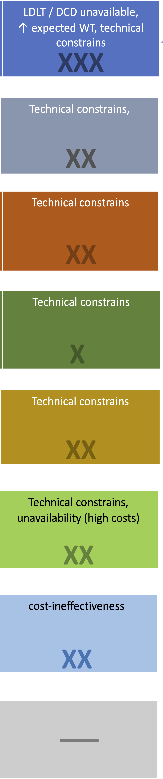
CERTAINTY OF SURVIVAL BENEFIT EVIDENCE
INDIVIDUAL RECOMMENDATION
MULTIPARAMETRIC MULTIDISCPLINARY EXPERT DECISION
BENEFITS
(desirable effects)
HARMS
(undesirable effects)
HARMS/BURDEN/VALUES AND PREFERENCES
FEASIBILITY, RESOURCES, ACCEPTABILITY, EQUITY
EXCLUDE THERAPY IF
(multifactorial weight)
CRITICAL TUMOR FEATURES
LIVER DYSFUNCTION
UNFIT
UNFEASIBILITY
Exclude
liver transplant
if
Exclude
Mini-invasive liver Resection
if
ORDINAL THERAPEUTIC HIERARCHY
Exclude
liver resection
if
THERAPEUTIC HIERARORDINALCHY
Exclude
percutaneous ablation
if
Exclude
video-laparoscopic ablation
if
Exclude
intra-arterial therapies
if
Exclude
systemic therapy
if
Best supportive care

Slide 37
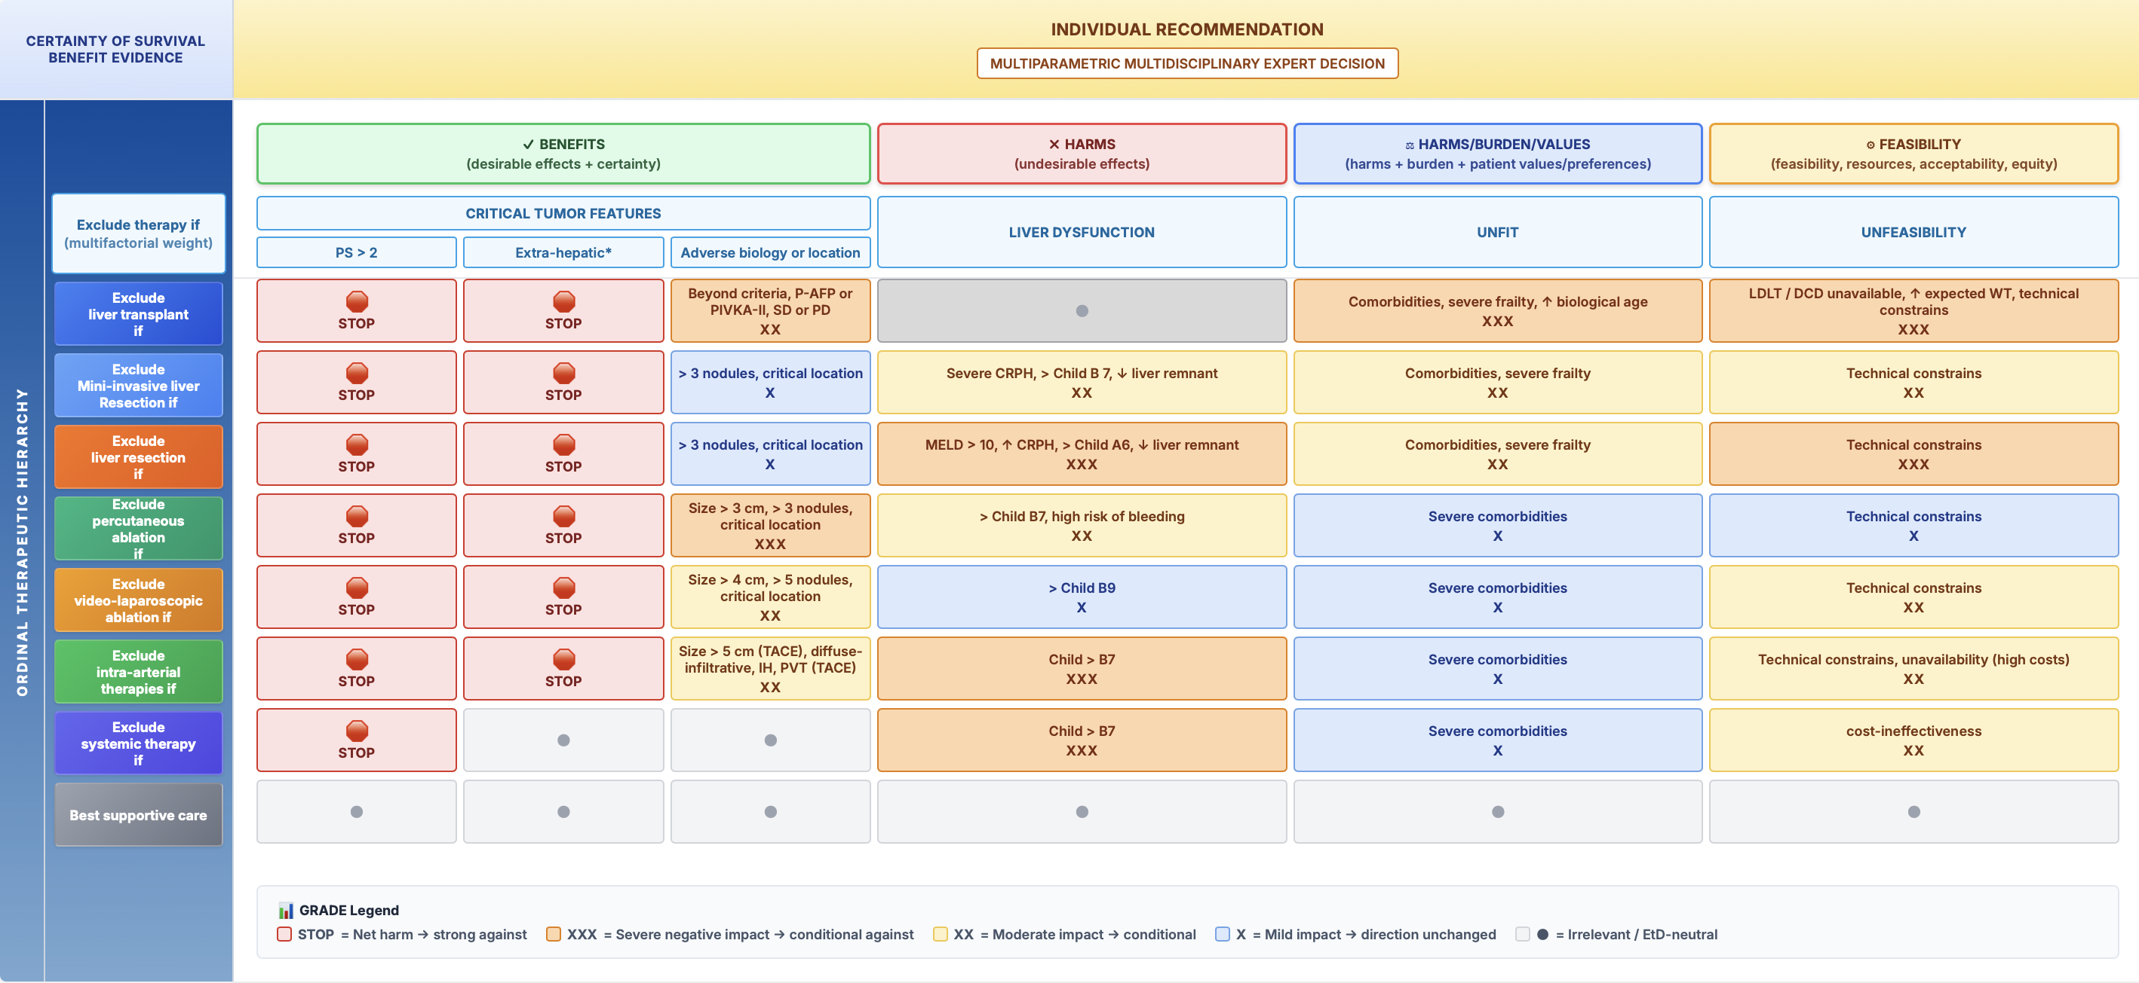
The Heisenberg’s uncertainty: the MTH-EtD proposal
MTH, «GRADE insipred» as a complete EtD framework for individual therapeutic decision-making • Transform MTH into a GRADE inspired Evidence‑to‑Decision tool for expert MDT meetings • Map each MTH dimension to GRADE EtD domains (benefits, harms, burden/values, feasibility/resources/equity) • Provide a transparent, reproducible, patient‑centred decision pathway

Slide 38
The Heisenberg’s uncertainty: the digital MTH-EtD proposal
Therapeutic Assistance and Decision algorithms for hepatobiliary tumor Boards (ADBoard) aim to reduce this delay by providing automated data extraction and high-quality, evidence-based treatment recommendations.
Ng et al. Trials (2023) 24:577. https://doi.org/10.1186/s13063-023-07610-8

Slide 39
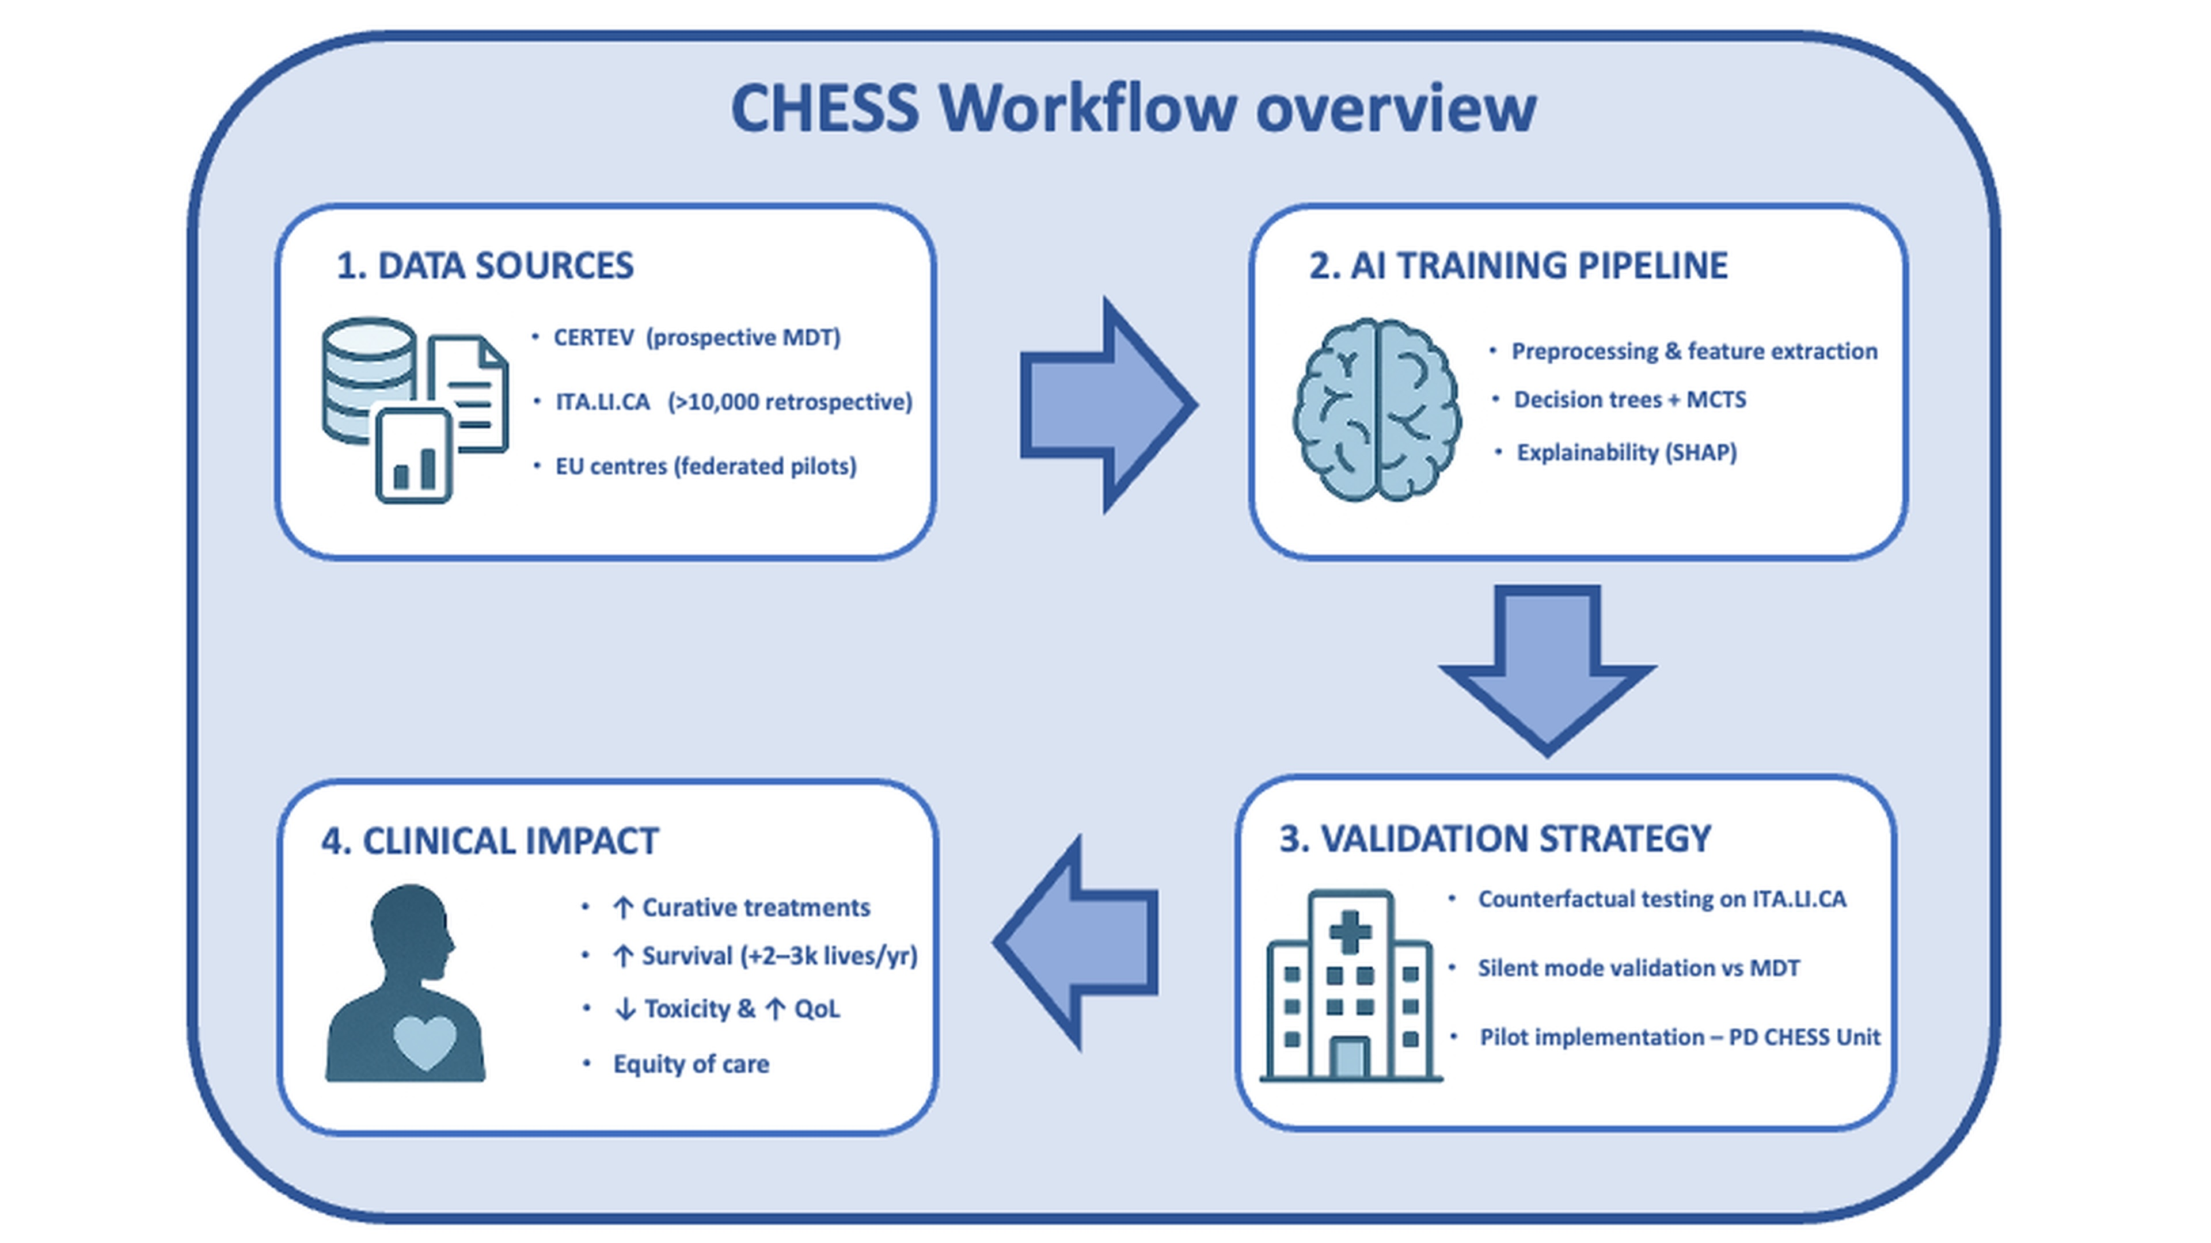
The Heisenberg’s uncertainty: the digital MTH-EtD proposal
The Clinician Helper Expert Strategy System (CHESS):
A “Strategic Game-Inspired” AI Copilot to Enhance Personalised Sequential Decision-Making in Hepatocellular Carcinoma

Slide 40
Multiparametric and Converse Therapeutic Hierarchy in HCC
From pre-Ptolemaic to Ptolemaic era
Merits of Stage Hierarchy
The Ptolemaic System
Boundaries of Stage Hierarchy
The Copernican and Newton’s evolutions
Multiparametric Therapeutic Hierarchy and expert MDT
The Einstein’s relativity
Converse Therapeutic Hierarchy
The Heisenberg’s uncertainty
Certainty of evidence is not dichotomic, is a continuum …
Uncertainty refers to individual and logistic complexities and should be always considered (by EtD tools and AI)
Notes:
The last slides I want to show you another conceptual evolution of this scheme. After embracing the ‘relativity’ of clinical decision-making (Einstein), we realized that HCC also contains a deeper level of complexity: a structural Heisenbergian uncertainty. Just as in Heisenberg’s principle, we cannot perfectly quantify all the dimensions that determine comparative treatment effectiveness — tumour biology, hepatic reserve, frailty, patient values, feasibility. This is precisely why we created MTH-GRADE: to transform inevitable uncertainty into a transparent, systematic and reproducible decision framework, fully aligned with the Core GRADE principles.

